Slide 1




MAJOR
PROJECT
A Comprehensive Study on Design and Optimization of
Network deception technologies (Honeypots)

Slide 2
OUR TEAM
1.
Aditya Chaurasia
2.
Samrat Dey
3.
Siddiqua Rahman
Guide: A. B. Thakur
(Assistant Professor)

Slide 3








CONTENTS
INTRODUCTION
ROAD MAP
THEORY
DEVELOPMENT
GOALS
TECH STACK
METHODOLOGY
CONCLUSION

Slide 4
INTRODUCTION
The evolution of cyber attack behavior in recent times has redendered traditional security technologies incapable of detection & prevention.
Honeypot technology serves as an active defense strategy that can effecively supplement the limitations of old network protection measures.
It aims to convert passive network defense into active defense through interaction with and tracking of intruders.

Slide 5
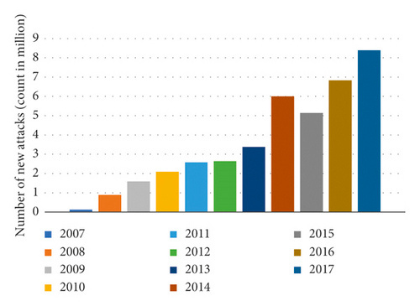
Graph showing attack trend evolution
1

Slide 6
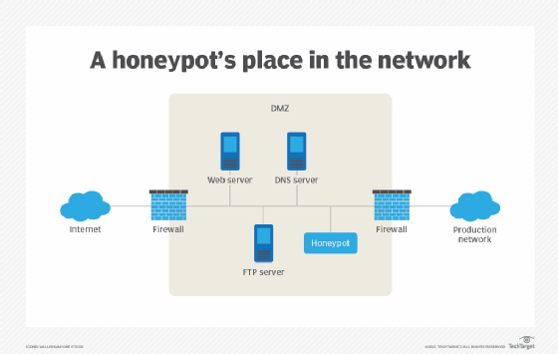
THEORY
Honeypots are decoy systems designed to attract attackers.
They help in analyzing cyber threats and strengthening defense mechanisms.
For example, Cowrie emulates SSH/Telnet to capture brute force attack.

Slide 7


THEORY
Low-Interaction Honeypots
High-Interaction Honeypots
Hybrid Honeypots
Simulate limited resources
Light-weigth and easy to maintain hence fewer resources
Collect basic information
Pose as legitimate network infrastructures
Resource intrusive
Provide deeper insights for attacker system
A combination of both for better balance
Less resources required than HIH and more data collected than LIH

Slide 8


THEORY
REAL-WORLD APPLICATIONS
ENTERPRISES USE THEM FOR THREAT INTELLIGENCE
Helps in detecting new cyber threats
Used in law enforcement to track cyber criminals
CHALLENGES IN DEPLOYMENT
ATTACKERS DETECTING AND EVADING HONEYPOTS
HIGH RESOURCE CONSUMPTION AND MAINTENANCE
ETHICAL CONCERNS AND FALSE POSITIVES

Slide 9
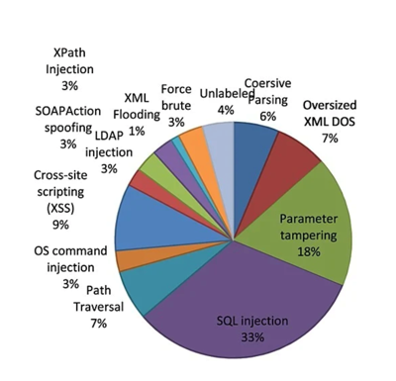
Attacks detected by WS Honeypot
2

Slide 10

GOALS
Enhancing network
security by studying
the efficiency and
design of current
honeypot systems
Identifying and
analysing vulnerabilities
by developing a
Honeypot network
analysis tool
Comparative study of frequently the honeypot systems tested for threat identification, and integration with other security measures

Slide 11

METHODOLOGY
Research
Development
Focusing on the the different types of Honeypot systems and determining the best use cases for each
Identifying challenges in technologies used such as false positives and resource consumption
Developing a user friendly vulnerability scanner that simulates real-world threats to effectively assess the resilience of commonly used honeypots
Comparative study of the honeypot technologies based on results

Slide 12
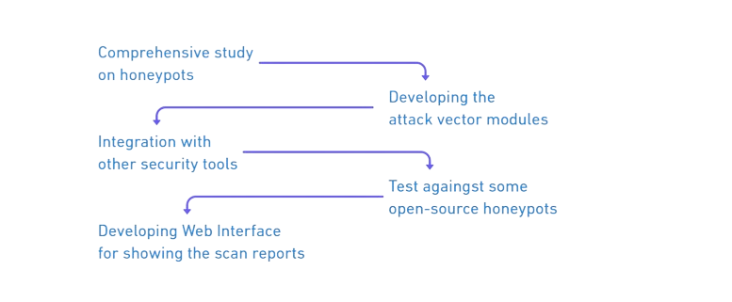
ROADMAP

Slide 13





DEVELOPMENT
PHASE 1
PHASE 2
PHASE 3
Work done on modules. It includes implementing all attack vectors
Developing and Hosting a dashboard after running scans on the test Honeypot networks
Research work and report writing to analyse our results and paper submission

Slide 14
TECH STACK
Programming language: python
Libraries: requests, paramiko
Web Technology: html5, css3, JavaScript, Bootstrap, Flask
Database: mongoDB
Cloud: AWS EC2
Tools used: Nmap, Nikto, WP-Scan,
Metasploit, Netcat, Trivy, Safety-cli,
Hping3, Slowhttptest, Docker
Protocols: SSH(22), HTTP(80)
Honeypots used:
SSH: Cowrie
HTTP: Conpot, Wordpot

Slide 15


INSIGHTS
Honeypots are highly static in nature making them vulnerable to fingerprinting
Vulnerable to DoS attack can lead to system crashes
Outdated dependencies and weak configurations
Regular updates, sandboxing, and strict access controls are necessary

Slide 16


FUTURE SCOPE
Improved scalability and modularity
Coverage of more protocols beyond SSH and HTTP
Real-time detection and response features
Automated log analysis

Slide 17

RELEVANT LINKS
Paper DOI: https://www.doi.org/10.58257/IJPREMS39220
Tool Documentation: https://github.com/3rr0r-505/HoneyPott3r/wiki
YouTube Demo: https://youtu.be/OIiUPNZWTNE

Slide 18
CONCLUSION
Honeypots face certain challenges which make them suitable only for specific field of use.
By proper study and scanning for vulnerabilities, we can find the appropriate use case and optimization techniques for commonly used honeypot technologies like Cowrie.
Developing a vulnerability scanner with Honeypots as the main focus to enhance defensive security.

Slide 19
THANK
YOU!

Slide 20
REFERENCES
[1] N. El Kamel, M. Eddabbah, Y. Lmoumen, and R. Touahni, "A Smart Agent Design for Cyber Security Based on Honeypot and Machine Learning," Wiley Online Library, [2020].
[2] A. Ghourabi, T. Abbes, and A. Bouhoula, "Characterization of attacks collected from the deployment of Web service honeypot," Wiley Online Library, [2013].
[3] Faldi, Dinamita Romadoni and M. T. Sumadi, "The Implementation of Network Server Security System Using Honeypot," ResearchGate, [2023].

